Slide 1
Loan Admin Management Application
Team 3 Batch 1

Slide 2
Team members
Shubham Gupta
Shubham Singh
Siddhesh Bandgar
Siddharth Singh
Srilekha

Slide 3
Problem Statement
Build an Admin system to provides a facility for GIS Global Employees to purchase items from GIS Global Mart and facilitates a flexible loan to purchase the items. It should manage the below Admin activities:
Admin login and validation through credentials
Maintaining the customer data.
Manage loan cards ie. add or delete or update loan cards
Maintain the item master data.

Slide 4
Services
Admin Login Service
Customer Data Management Service
Loan Card Management Service
Item Master Management Service

Slide 5
Toolchain
Databases: MySQL
Presentation Layer: React
Backend processing: Springboot
Database Connectivity: Spring data JPA
Version control systems: Git
Build Tools: Maven

Slide 6
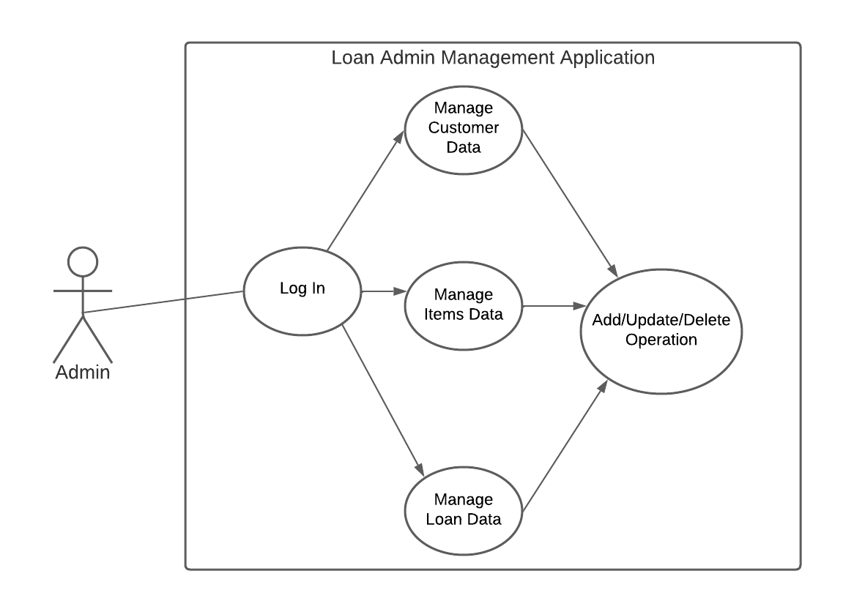
Use Case Diagram

Slide 7
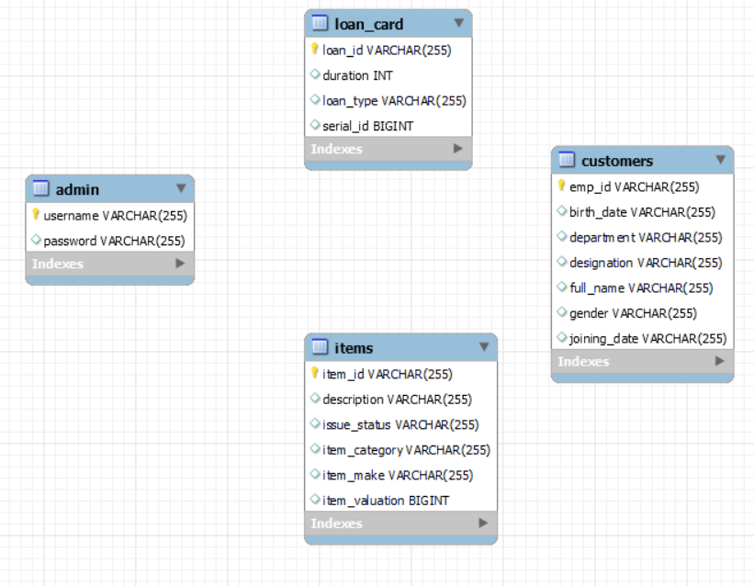
Database Schema

Slide 8
Tables Involved
admin
customer
item
loan_card
username
password
emp_id
full_name
designation
department
gender
birth_date
joining_date
Item_id
Description
Issue_status
Item_make
Item_valuation
loan_id
duration
loan_type
serial_id

Slide 9
Project Demo Screenshots

Slide 10
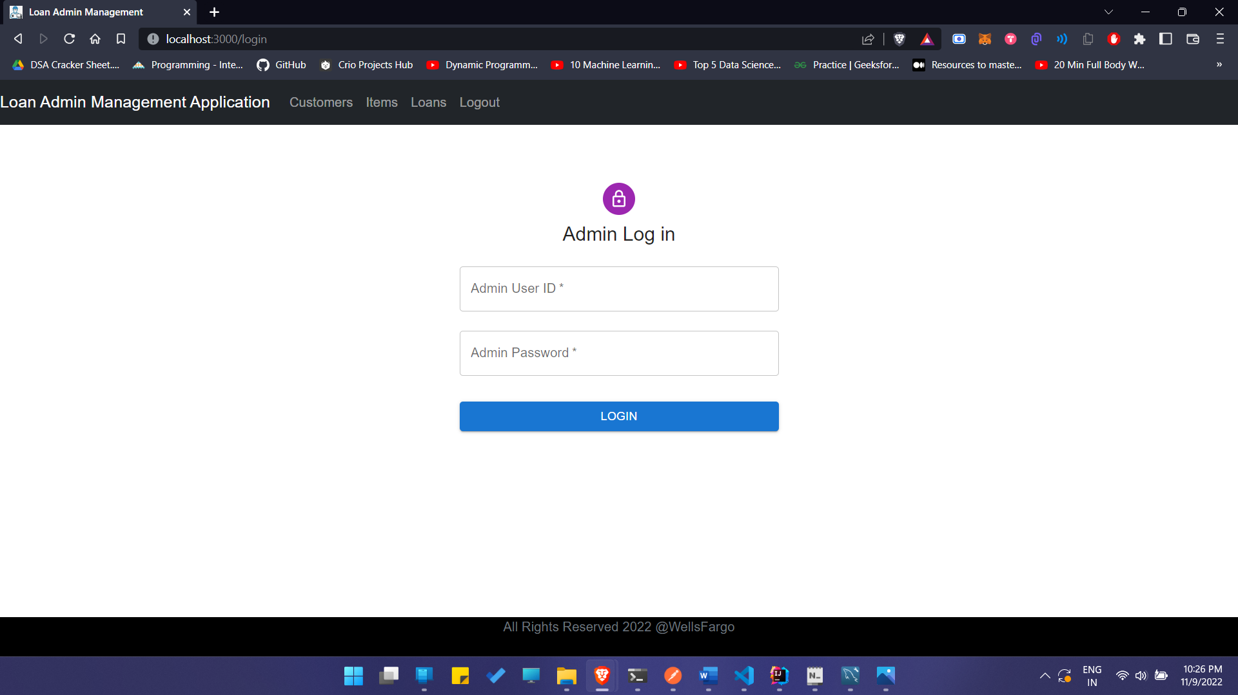
Admin Login Page

Slide 11
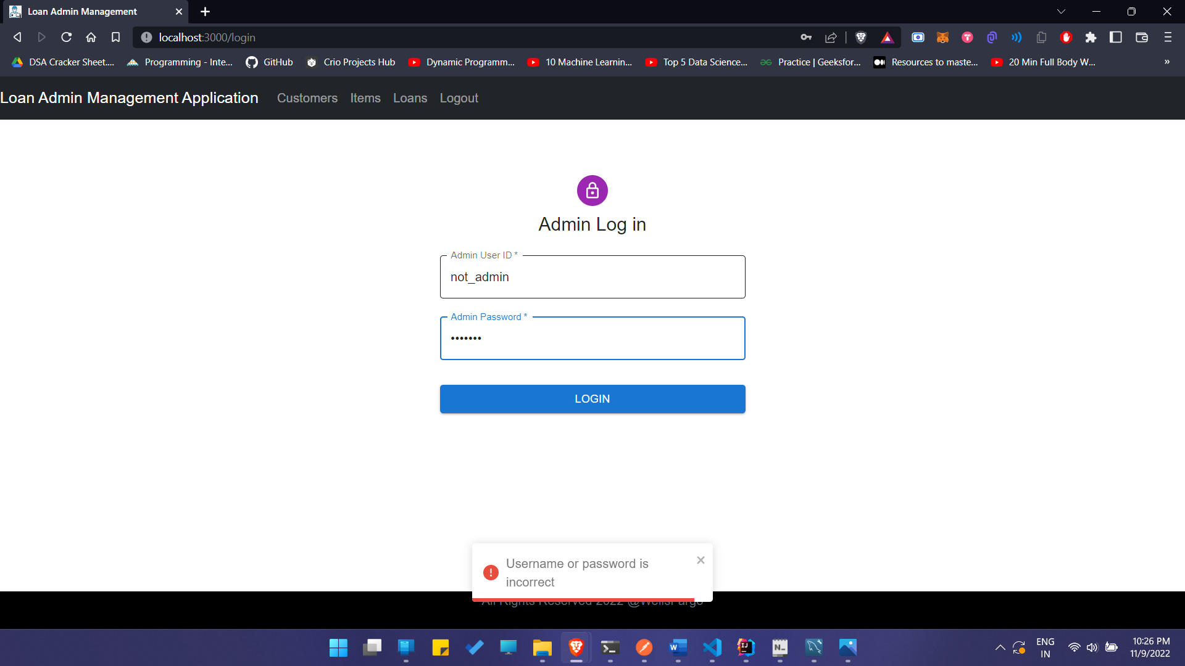
Admin Login Error Popup

Slide 12
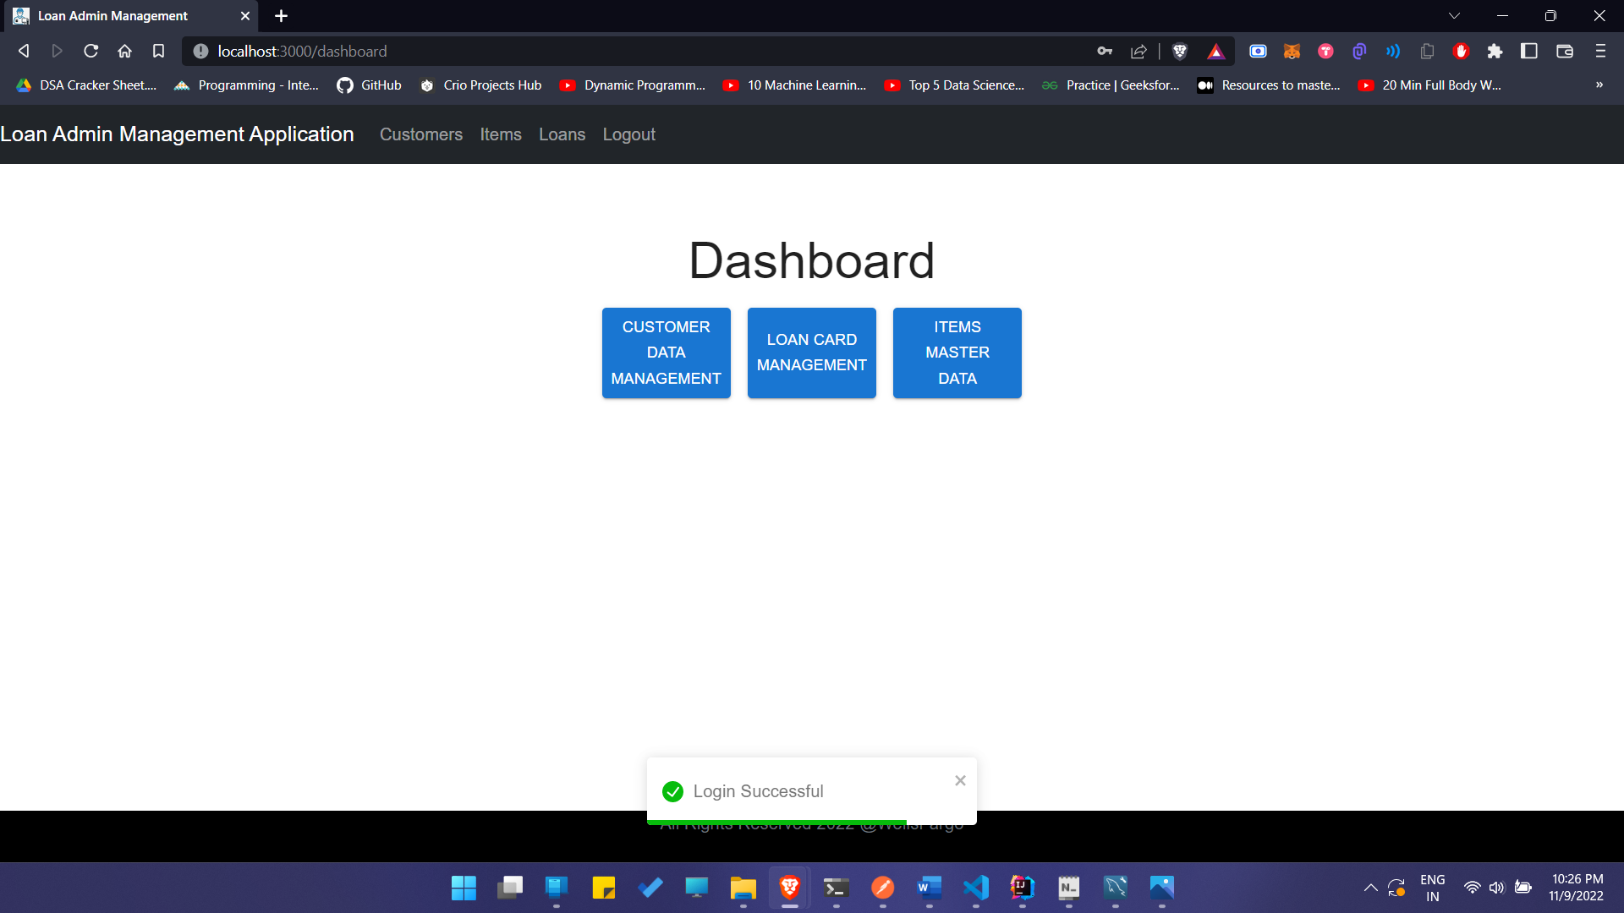
Dashboard (Login Successful)

Slide 13
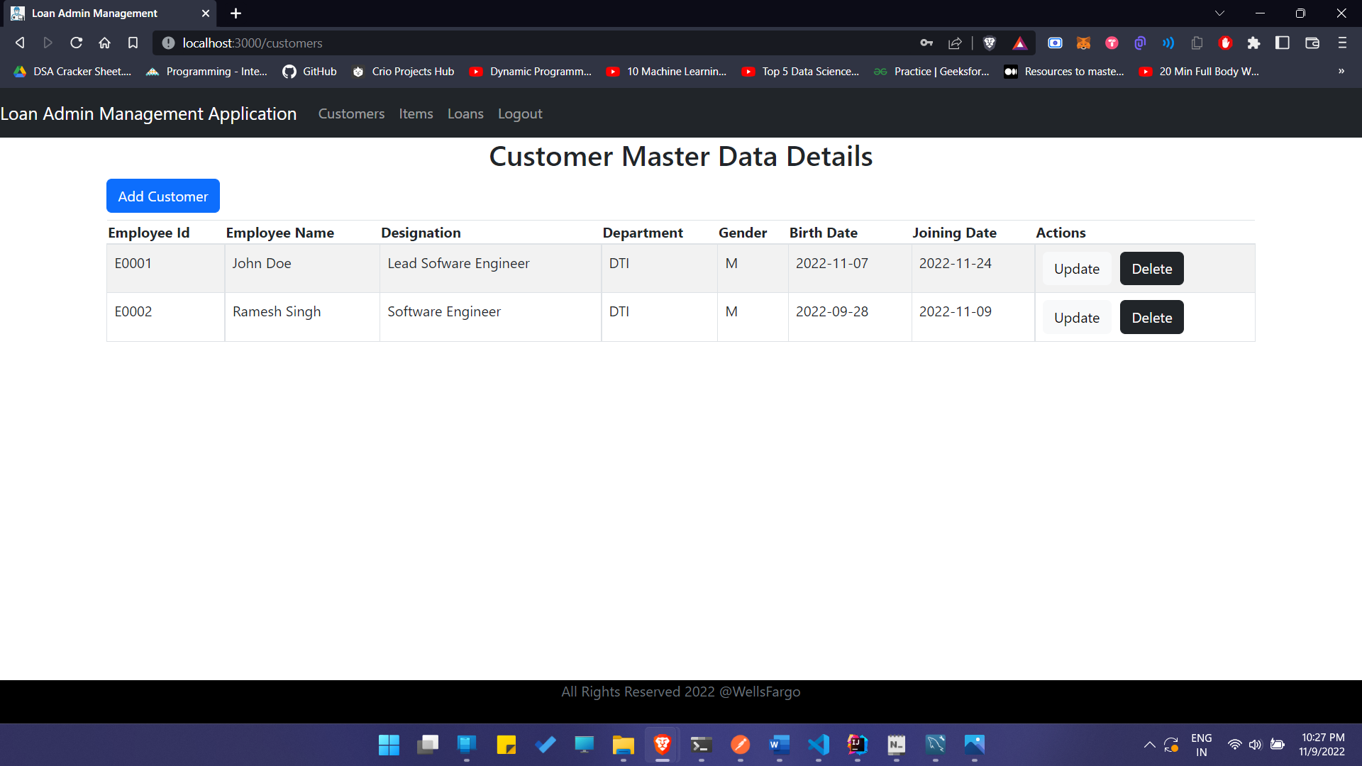
Customer Master Data

Slide 14
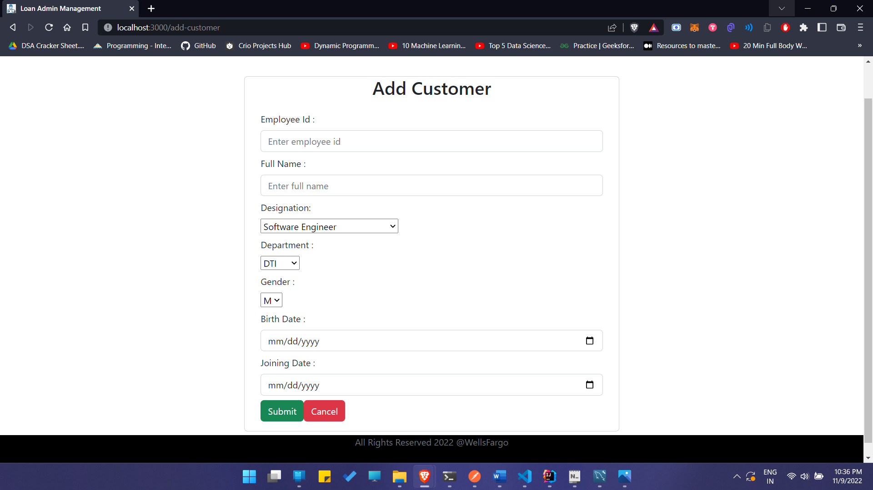
Add Customer

Slide 15
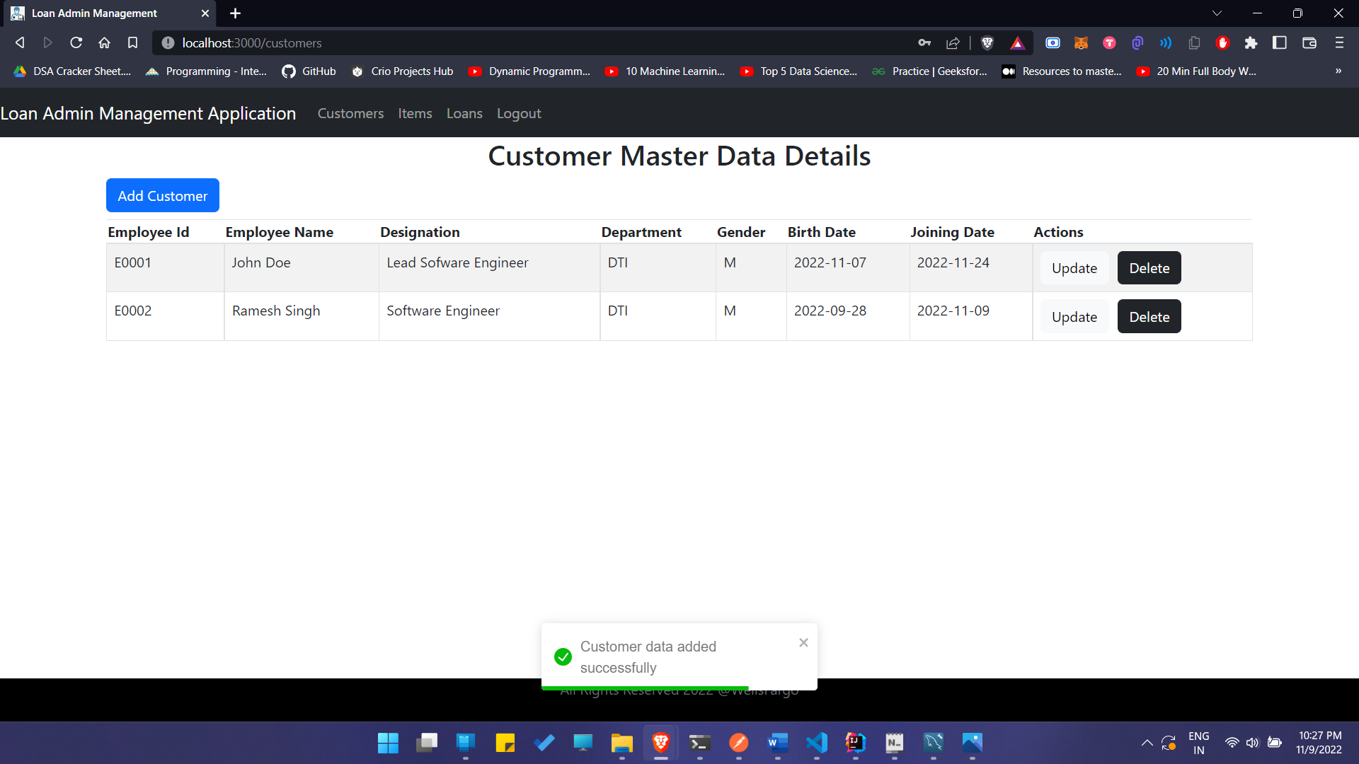
Customer Added Successfully

Slide 16

Customer Updated Successfully

Slide 17
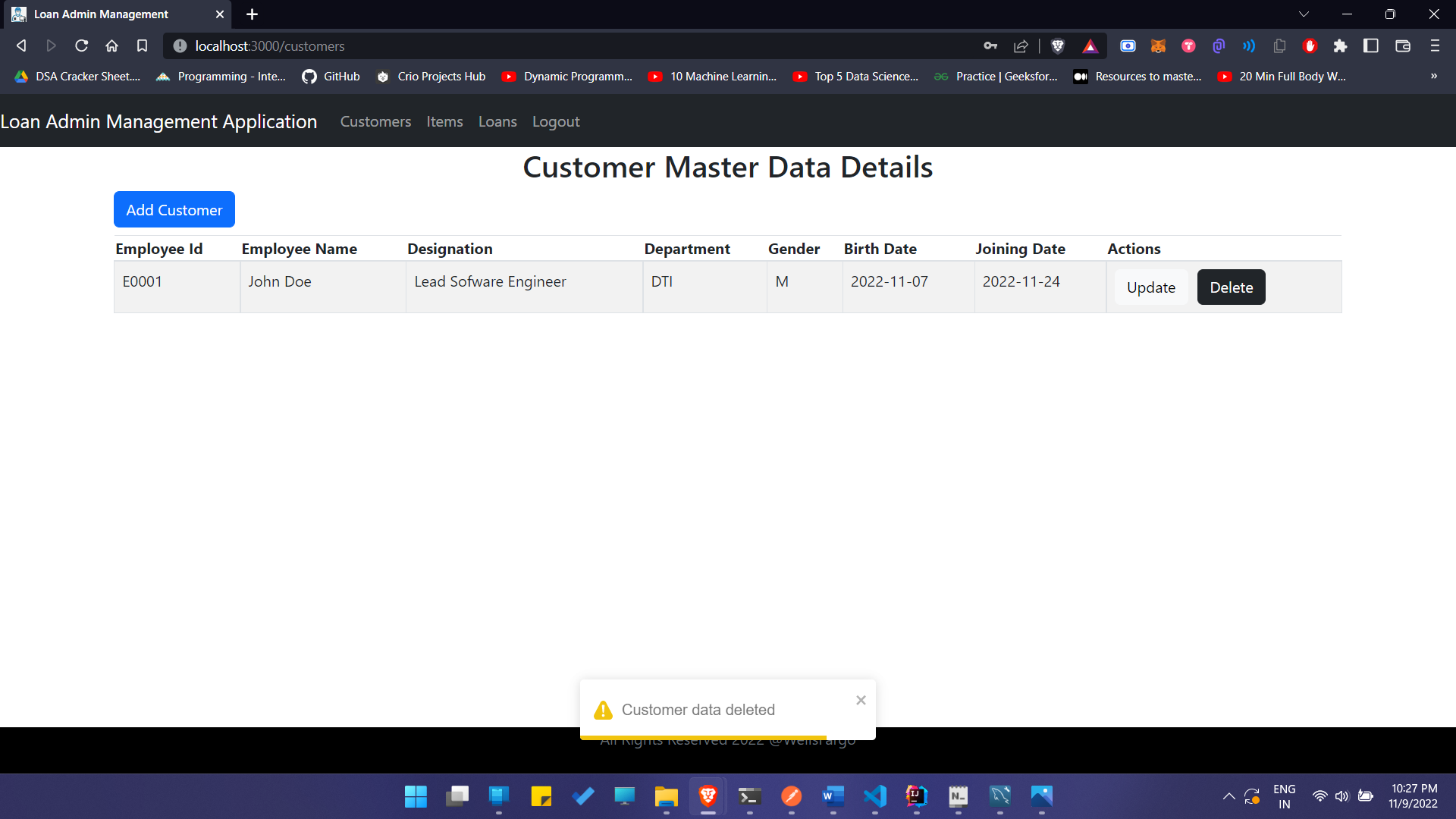
Customer Deleted

Slide 18
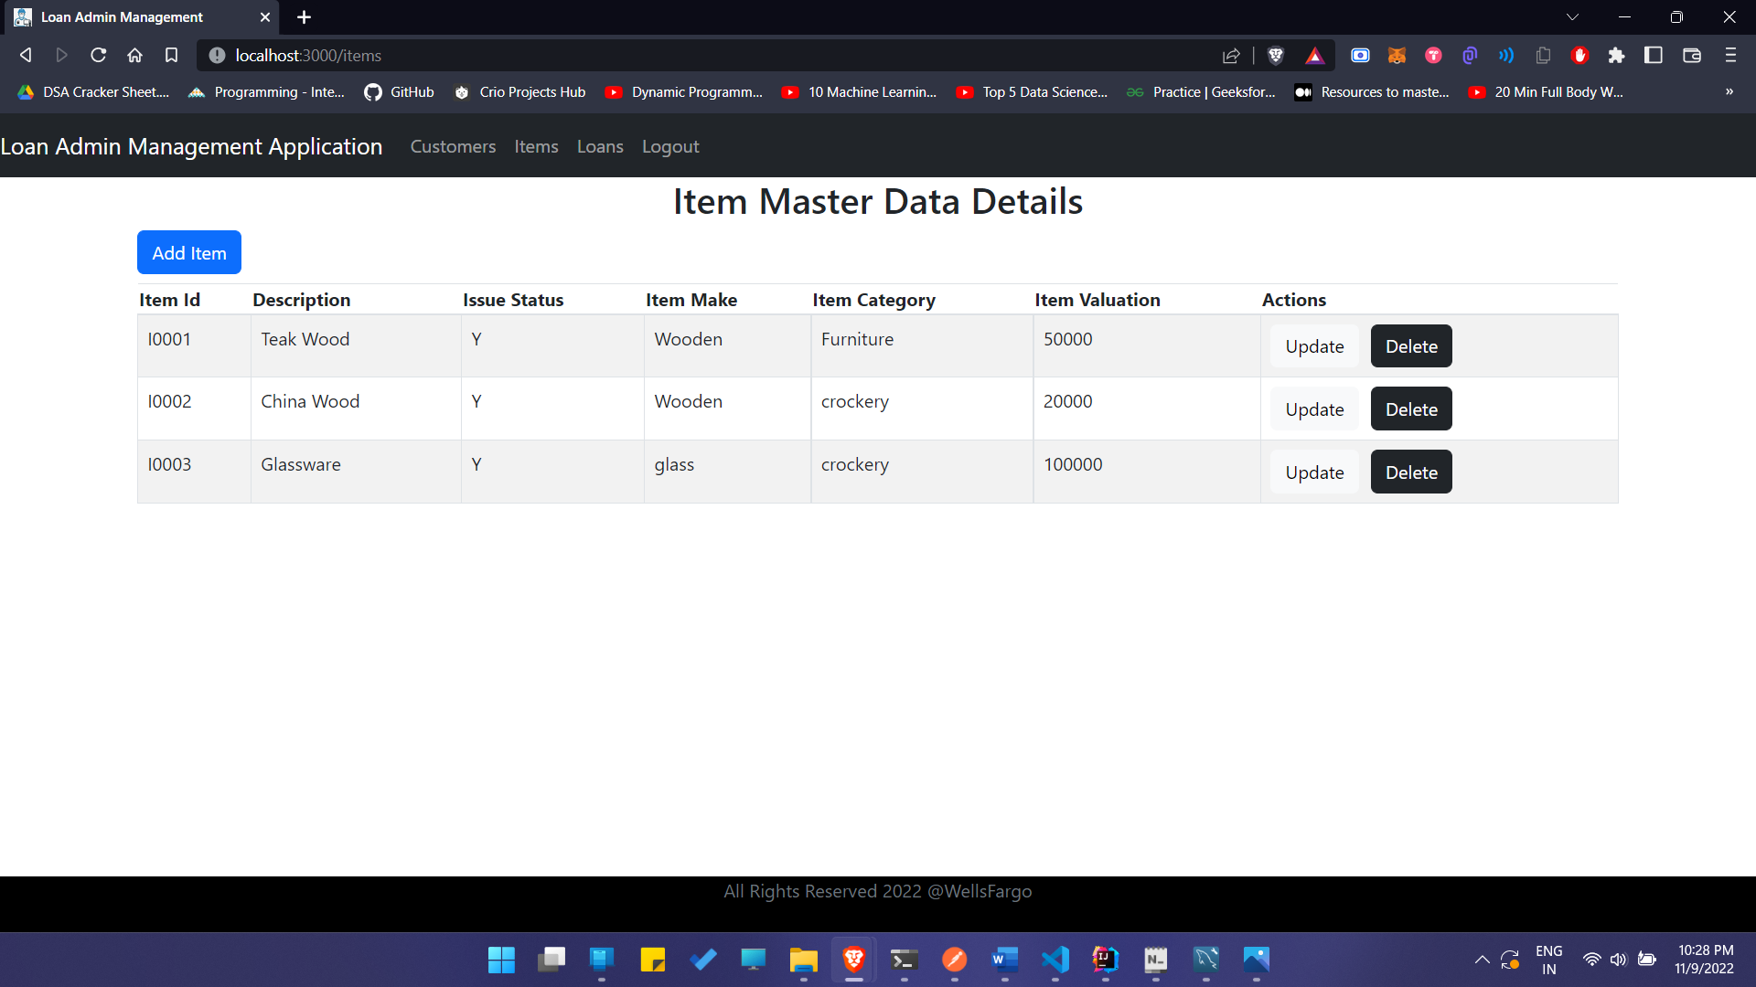
Items Master Data

Slide 19
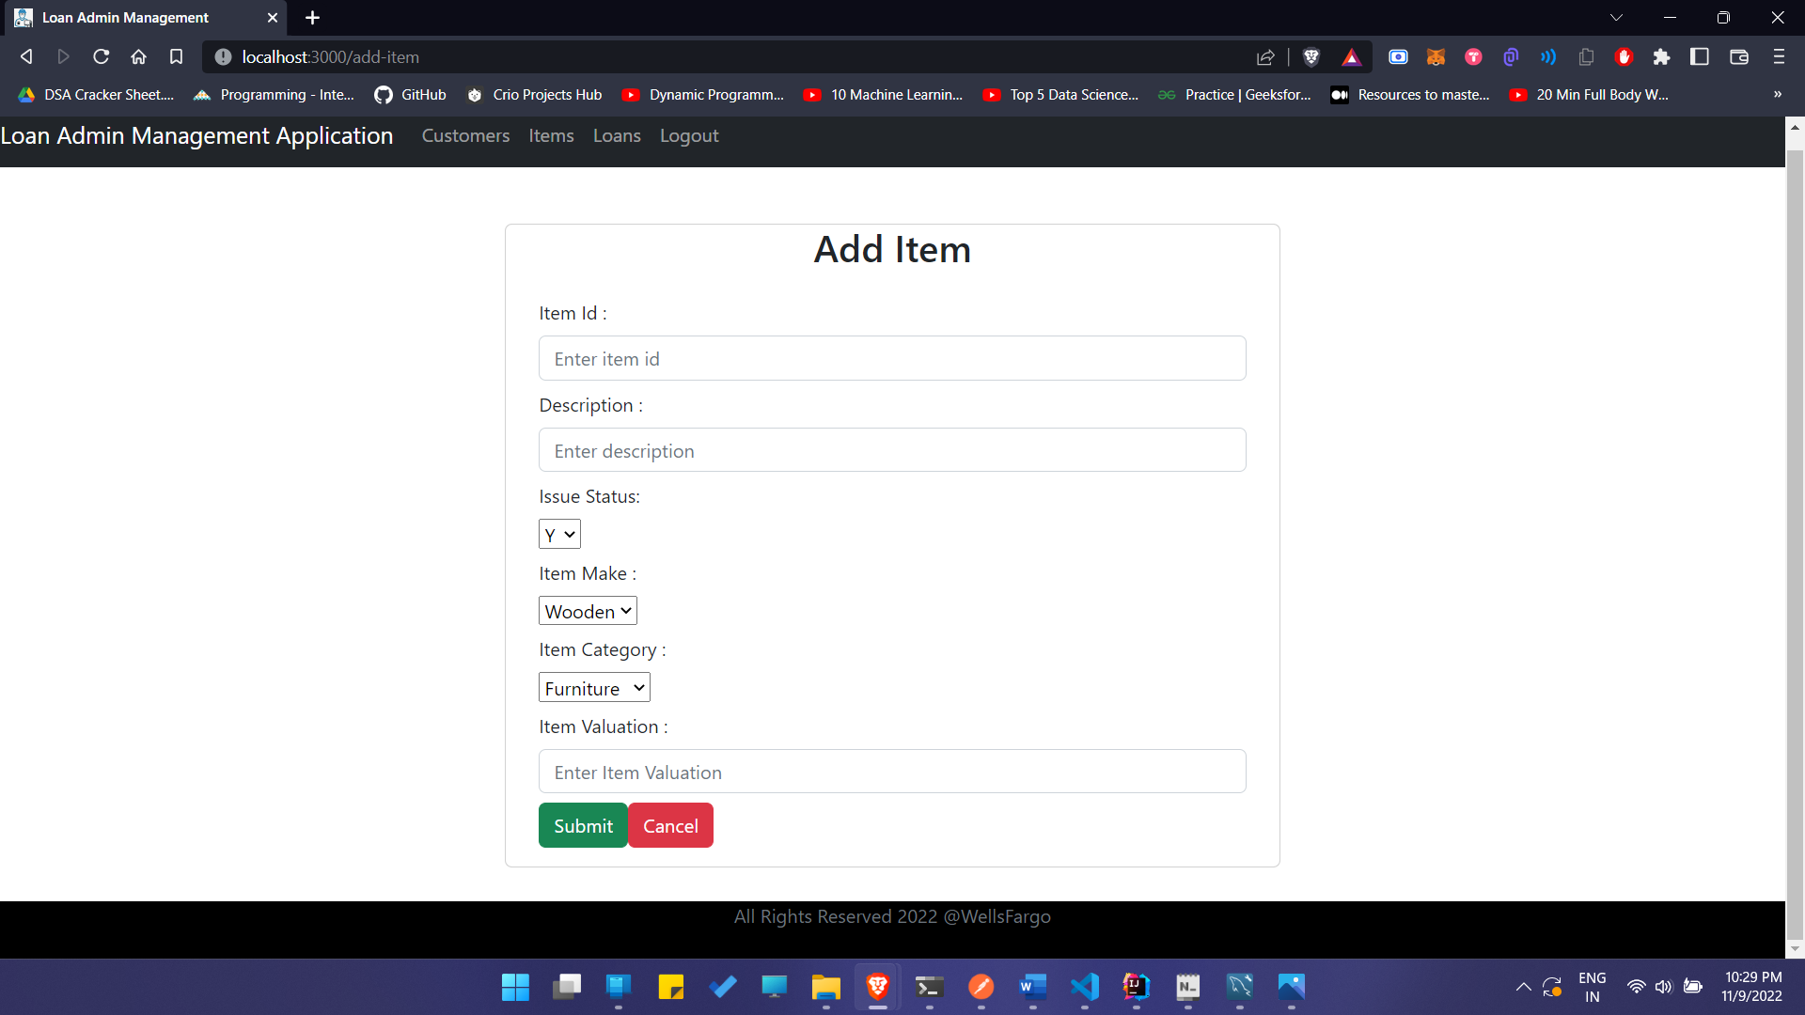
Add Item

Slide 20
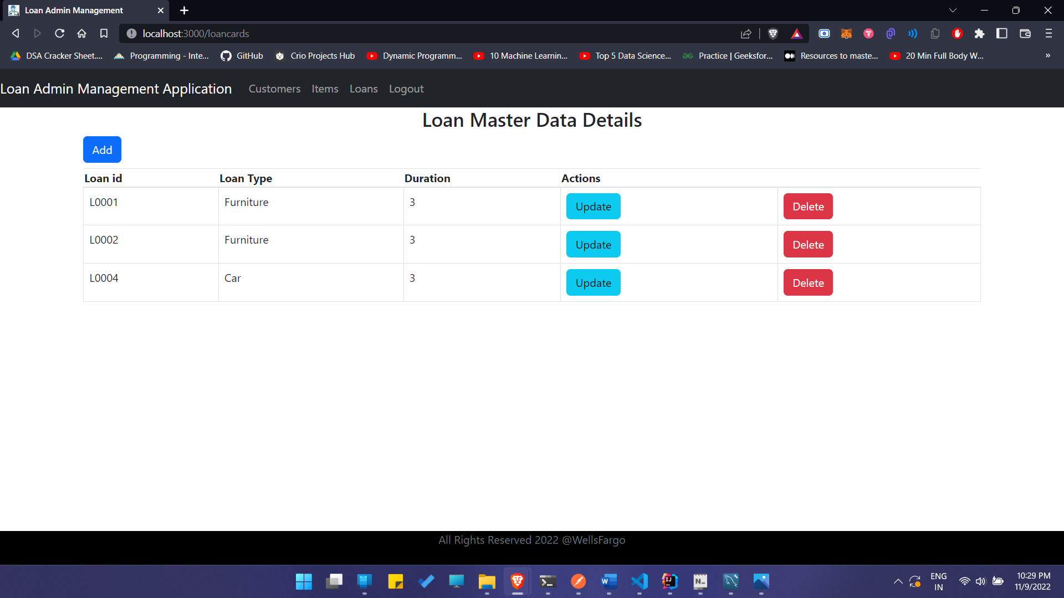
Loan Master Data

Slide 21
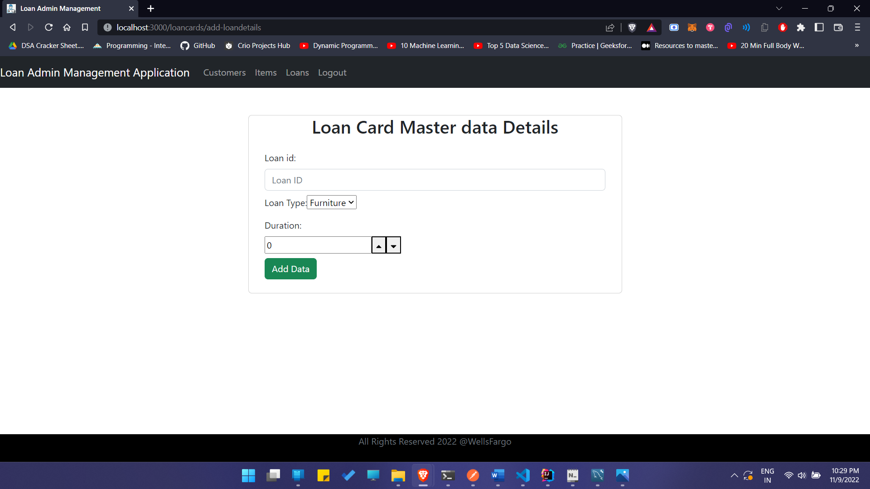
Add Loan Data

Slide 22
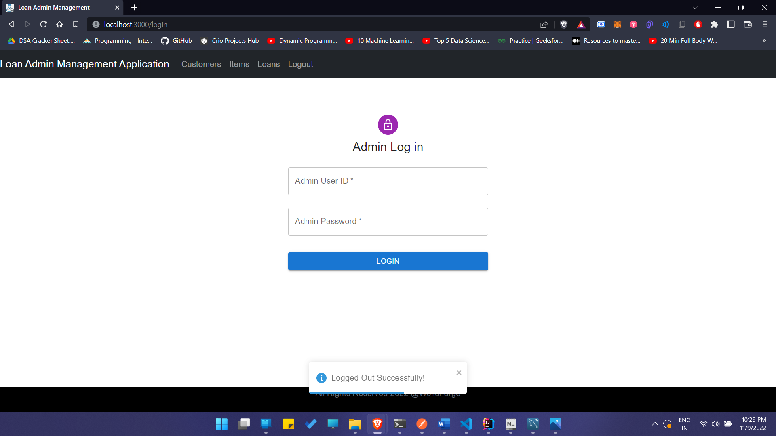
Logout

Slide 23
Thank you!

